Slide 1
GIL DEKEL, JAMES KLUZ,
UMAN SHAHZAD, AND MICHAEL MATTHEW SY
WEDNESDAY, MAY 17TH, 2017

Slide 2
GIL DEKEL, JAMES KLUZ,
UMAN SHAHZAD, AND MICHAEL MATTHEW SY
WEDNESDAY, MAY 17TH, 2017

Slide 3




WORK DISTRIBUTION
Team Coordinator
Gedder Algorithm Design
XML GUI Design and Implementation
Software Architecture Design & Implementation
Gedder Algorithm Design
Google Places API
Integrate XML GUI to Application
Software Architecture Design & Implementation
Gedder Algorithm Implementation
Version Control Management
Code Refactoring
Code Documentation
Website Development
Design & Implementation of Google Map Interface Module
Data Collection
Testing and Bug Discovery in Prototypes and Gedder 1.0

Slide 4


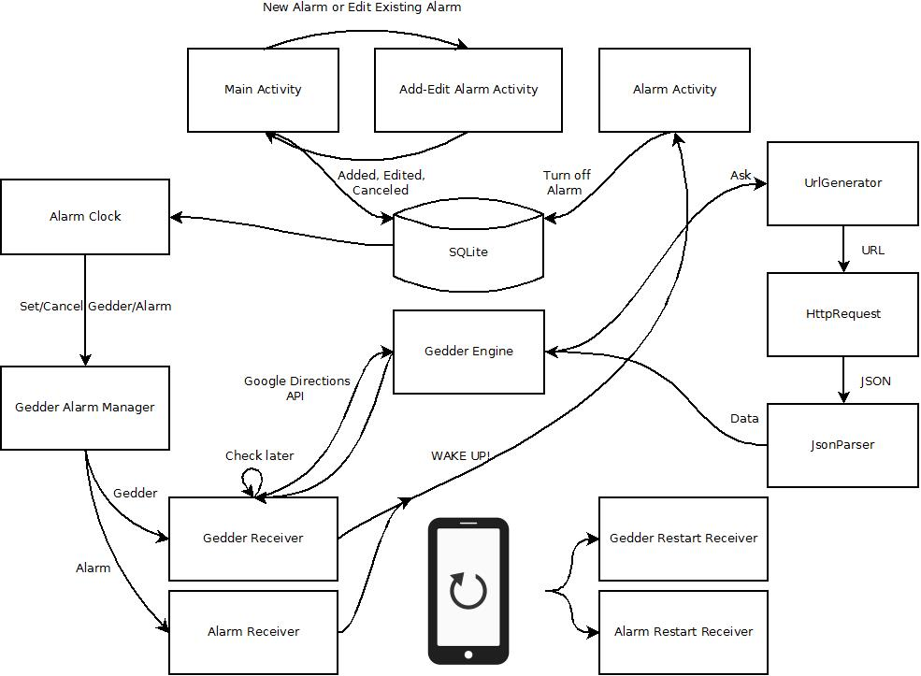
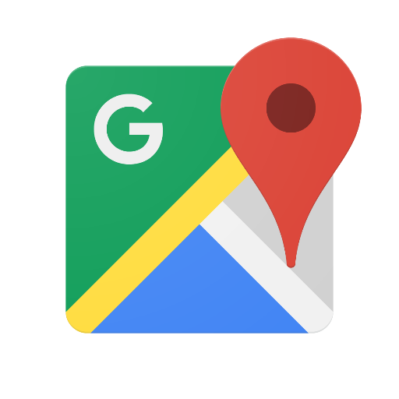

GEDDER’S ARCHITECTURE AND TECHNOLOGIES

Slide 5
GEDDER’S ARCHITECTURE AND TECHNOLOGIES

Slide 6
GEDDER’S ARCHITECTURE AND TECHNOLOGIES

Slide 7
GEDDER’S ARCHITECTURE AND TECHNOLOGIES

Slide 8


Slide 9
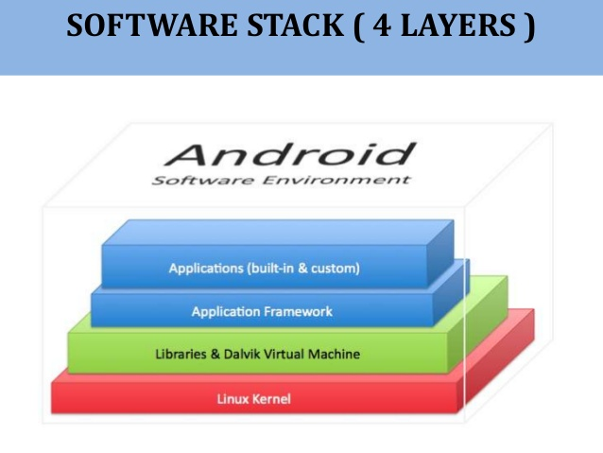
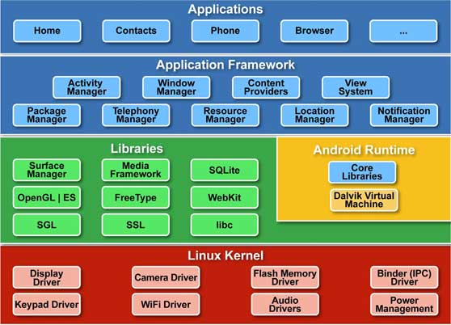
FOUR LAYERS OF ANDROID

Slide 10
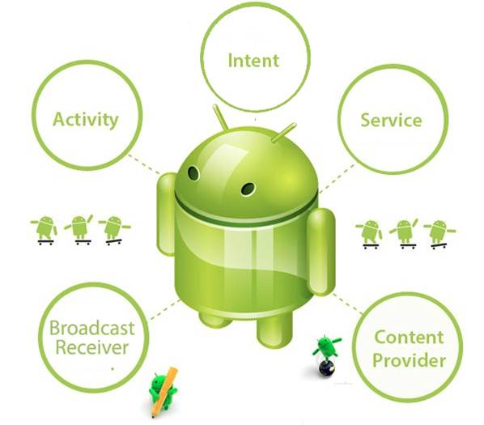
FOUR PRINCIPLE CLASSES
THE FOUR PRIMARY CLASSES OF ANDROID:
Activities
Broadcast Receivers
Content Providers
Services/Managers
Intents → The glue between the classes

Slide 11
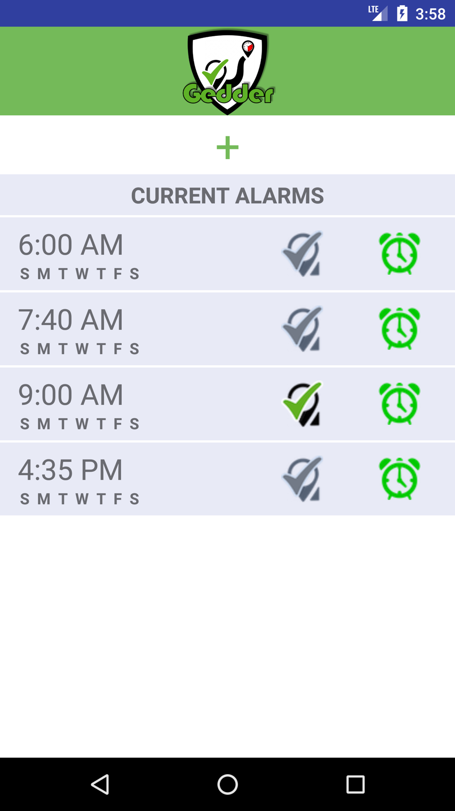
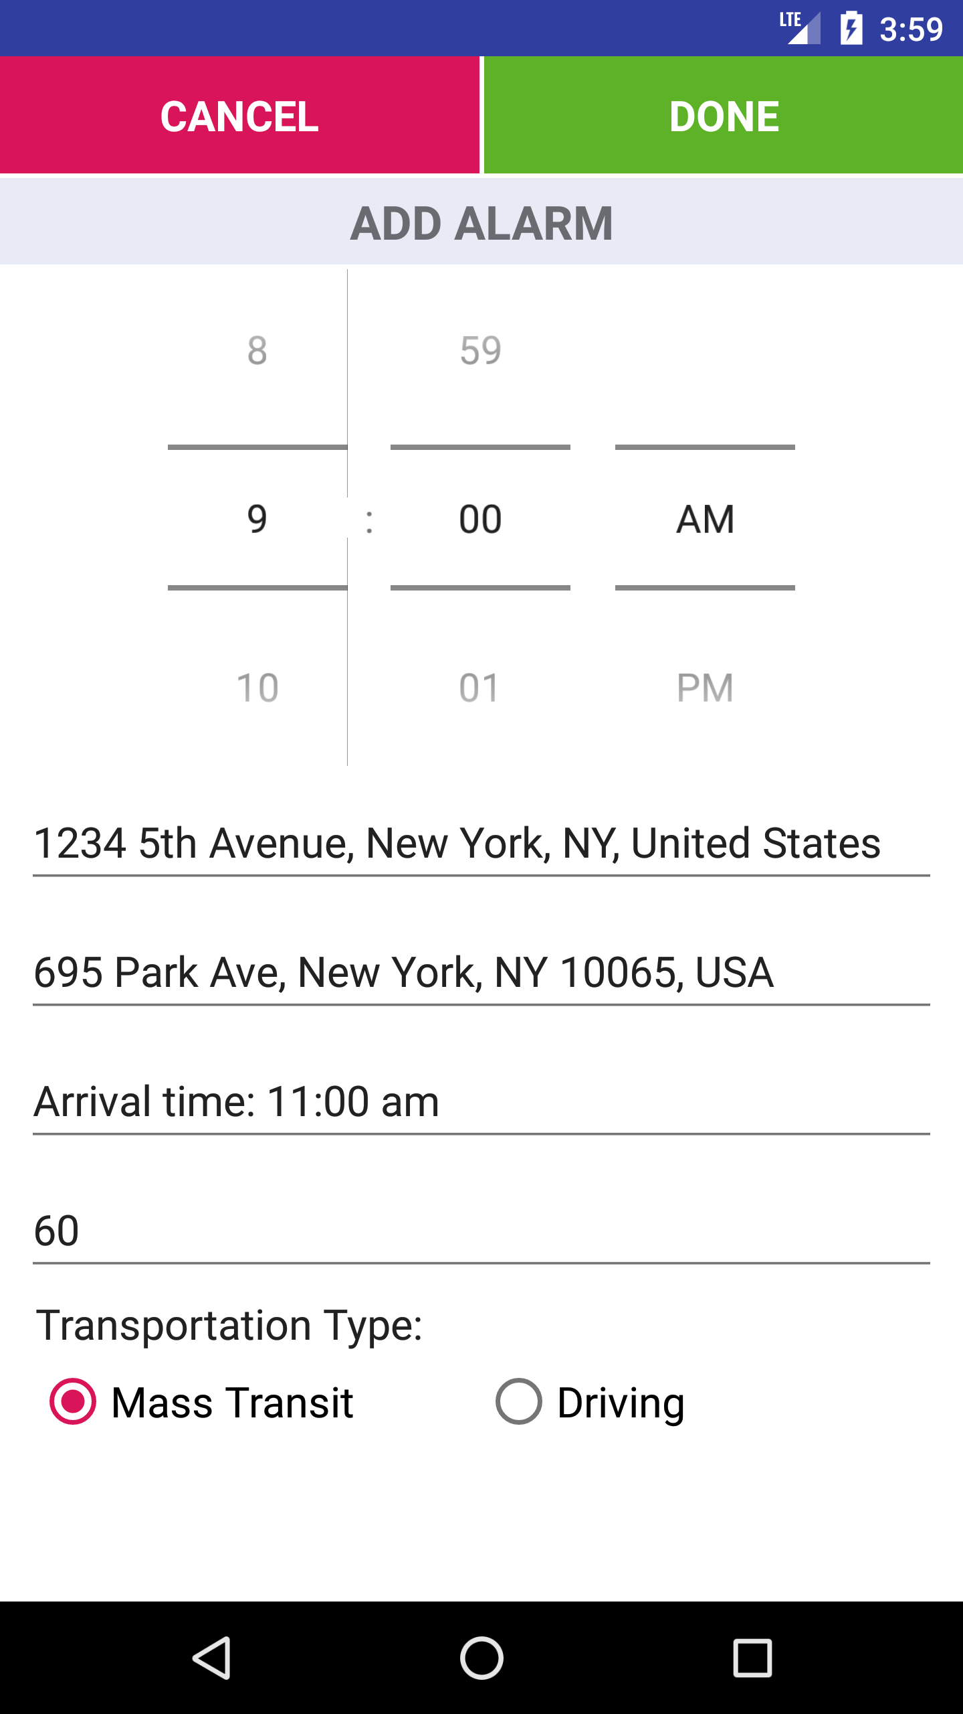
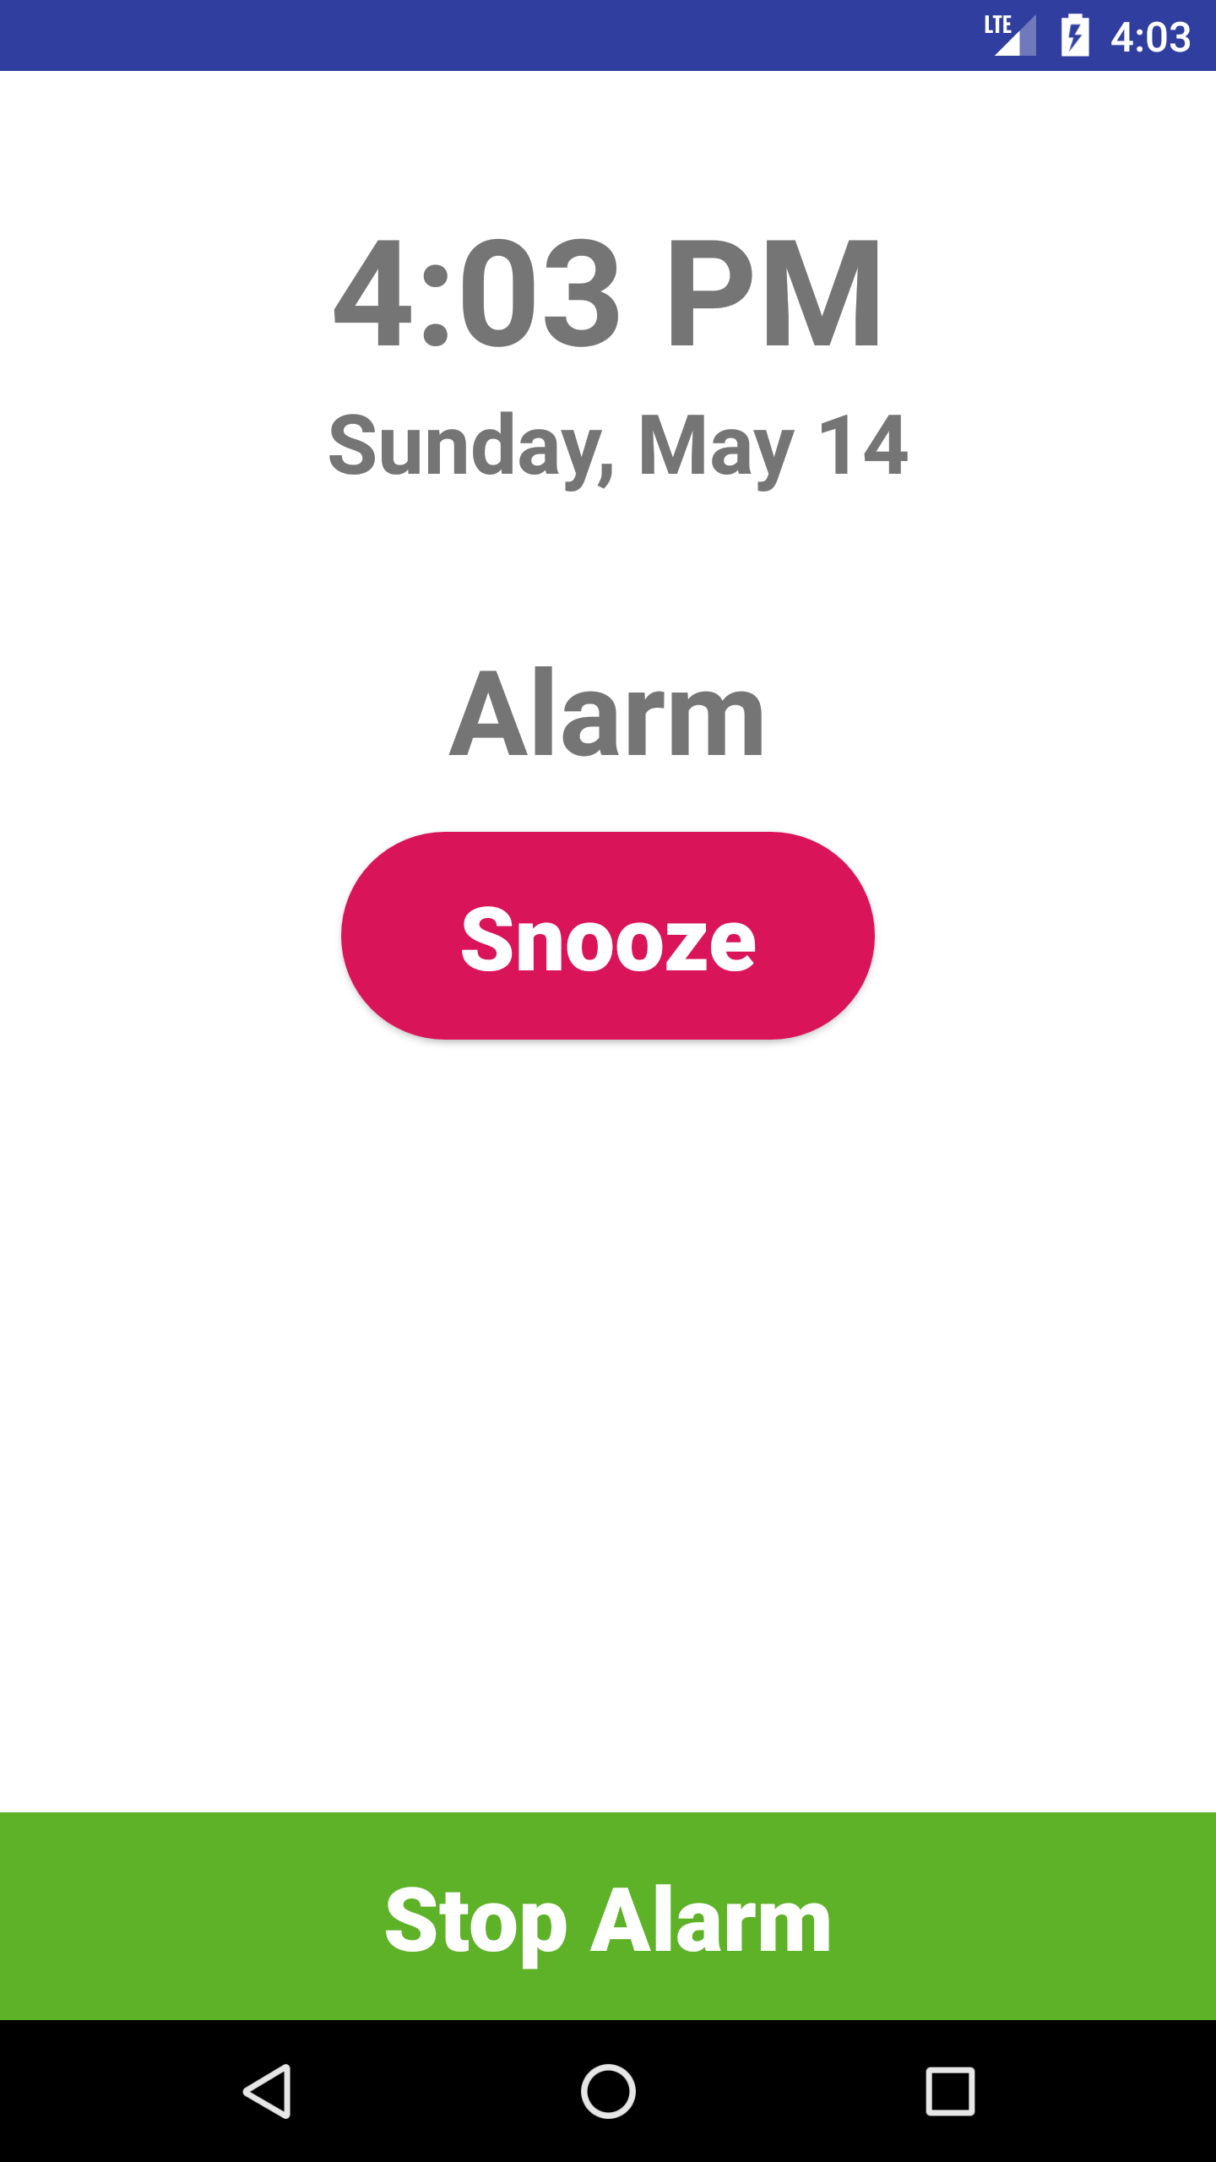
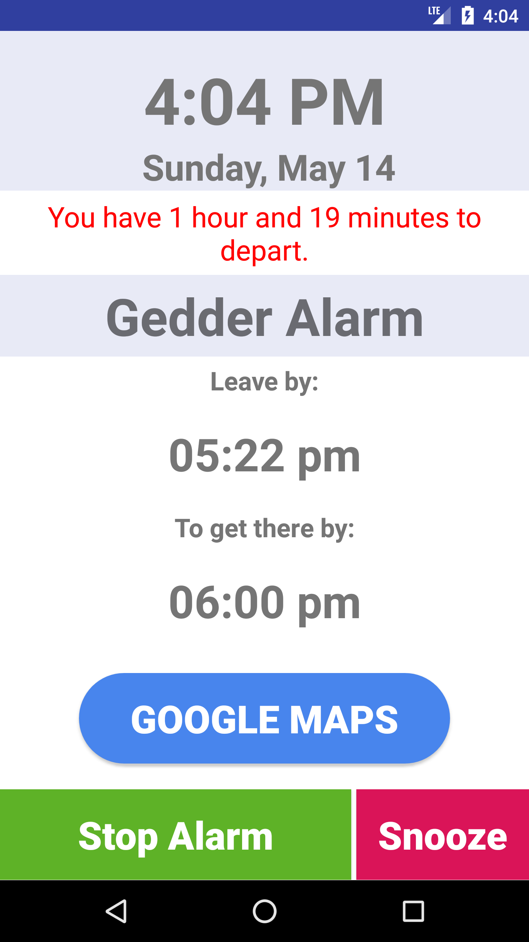
ACTIVITIES
ACTIVITIES REPRESENT A SCREEN IN AN APP
Main Screen
Add/Edit Alarm
Regular Alarm
Gedder Alarm
* Four different screens == four Gedder activities

Slide 12
ACTIVITIES

Slide 13
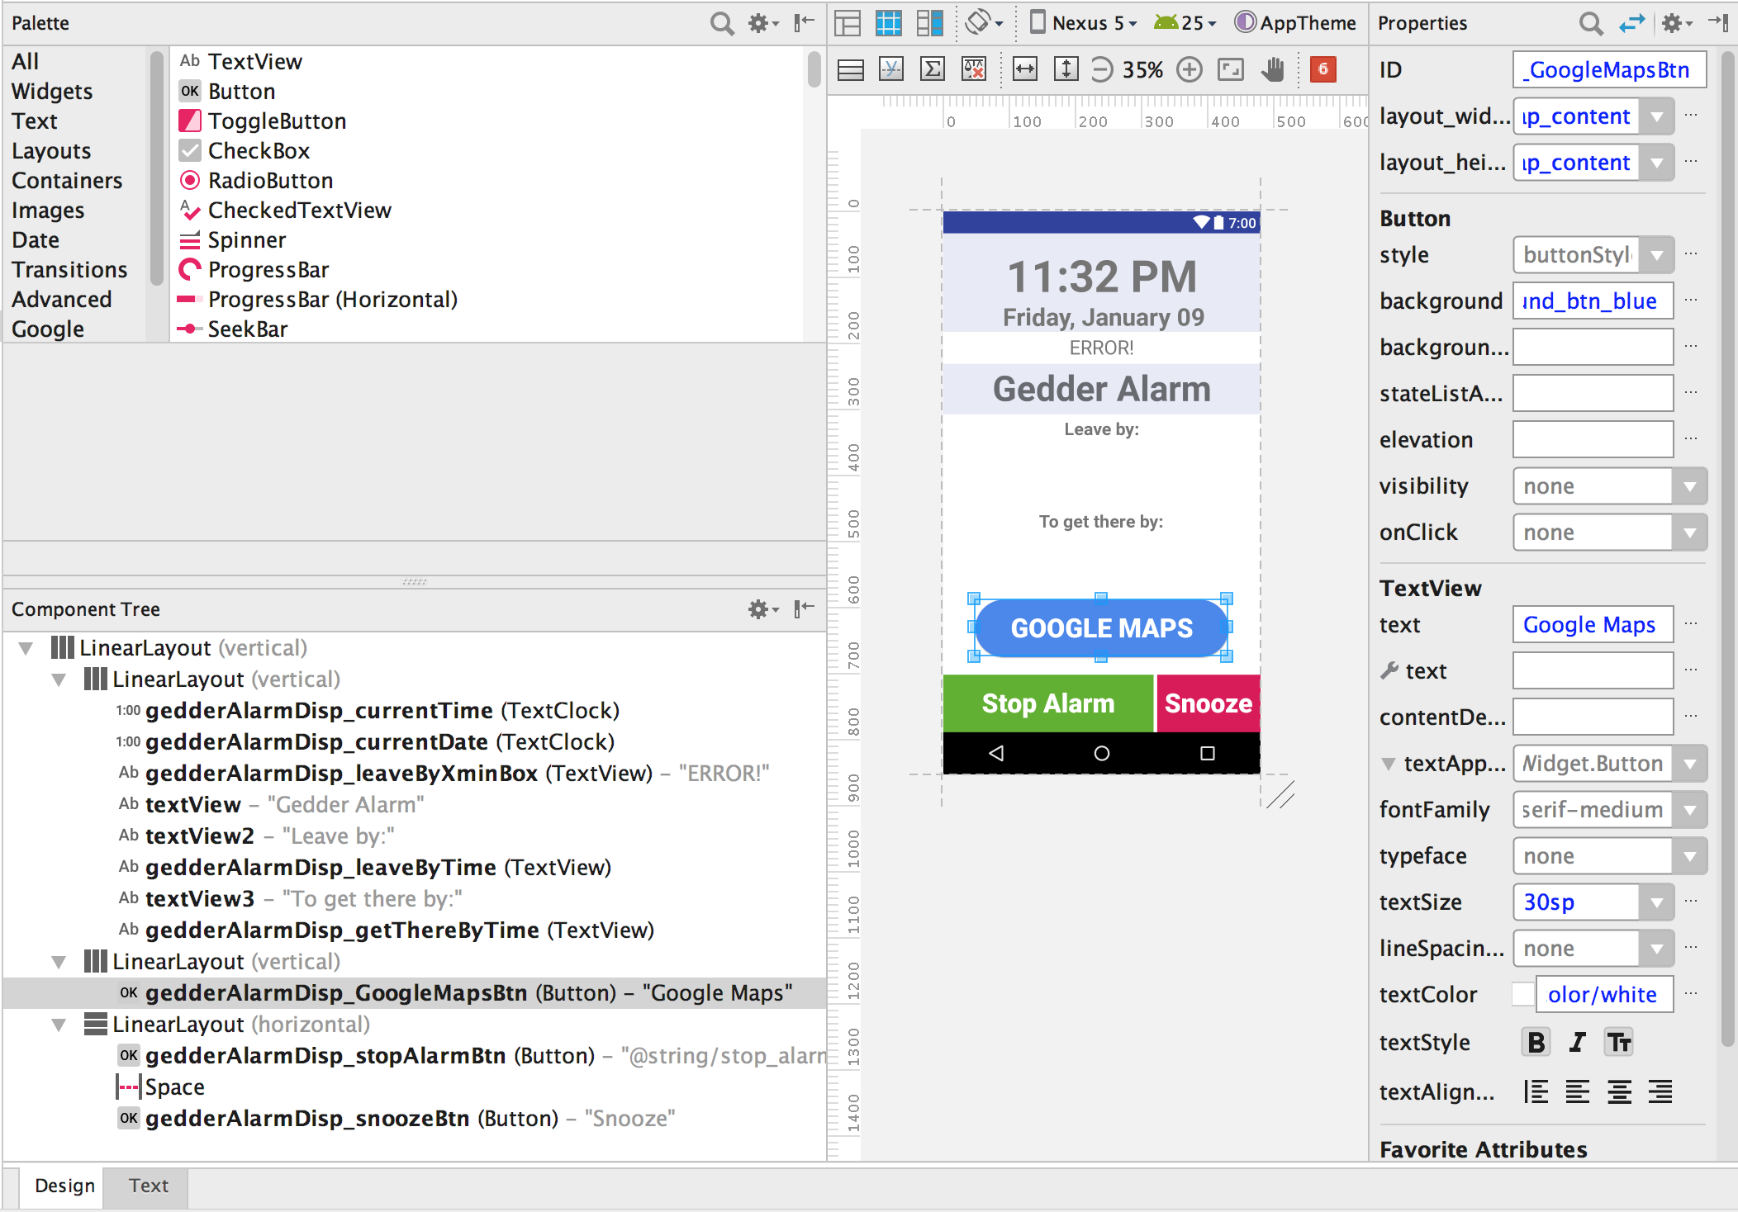
ACTIVITIES

Slide 14
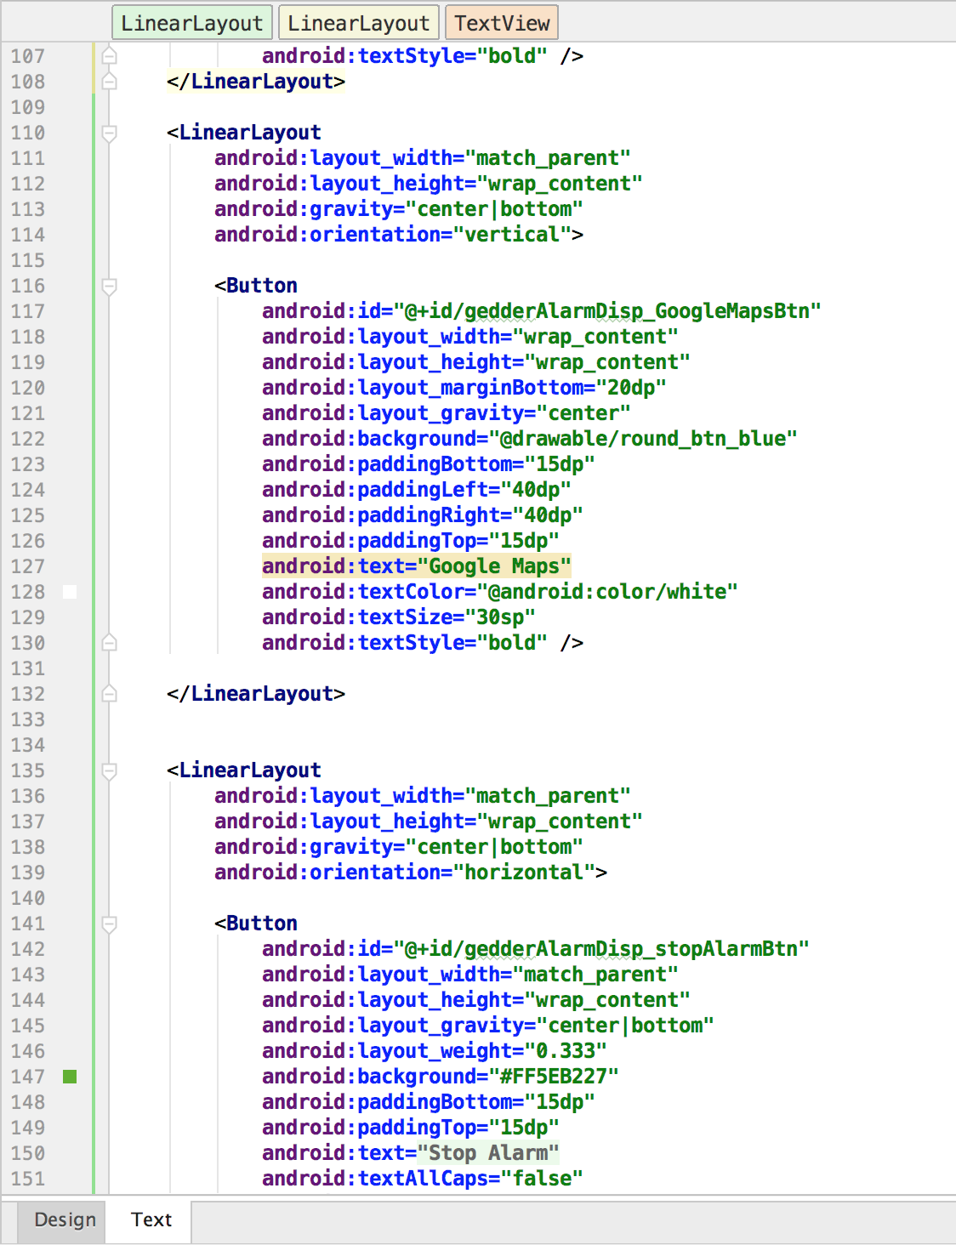
ACTIVITIES

Slide 15
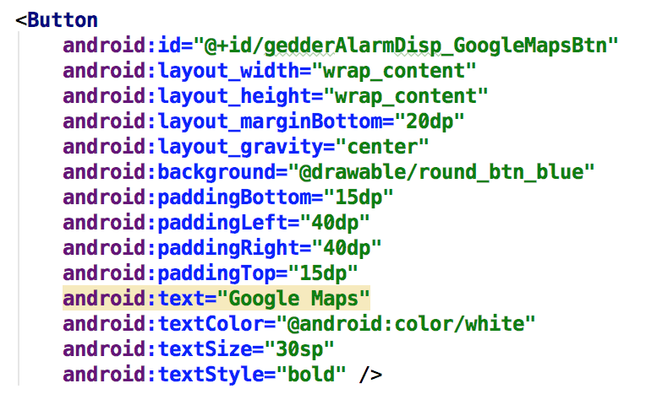
ACTIVITIES
XML Layout file

Slide 16
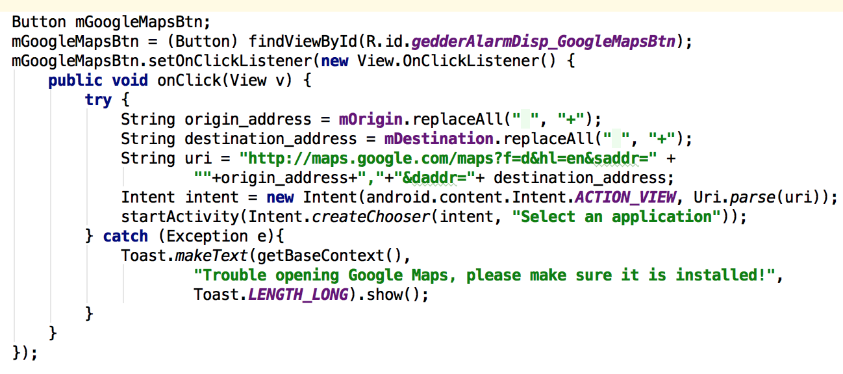
ACTIVITIES
XML Layout file
Java File

Slide 17
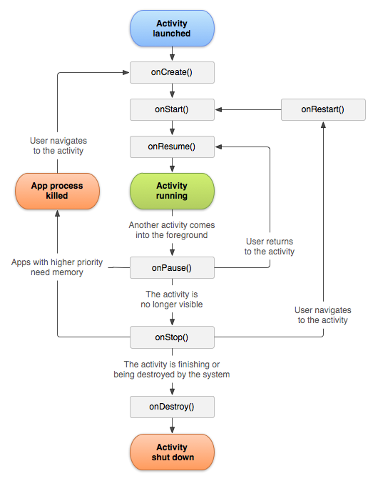
ACTIVITIES
ACTIVITY LIFECYCLE
Every activity has these methods
We can override these methods to customize our activity’s behavior

Slide 18
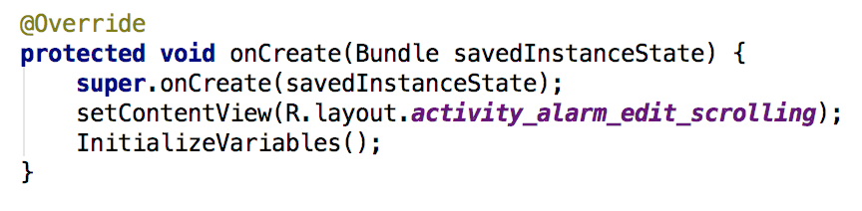
ACTIVITIES
ACTIVITY LIFECYCLE
Every activity has these methods
We can override these methods to customize our activity’s behavior

Slide 19
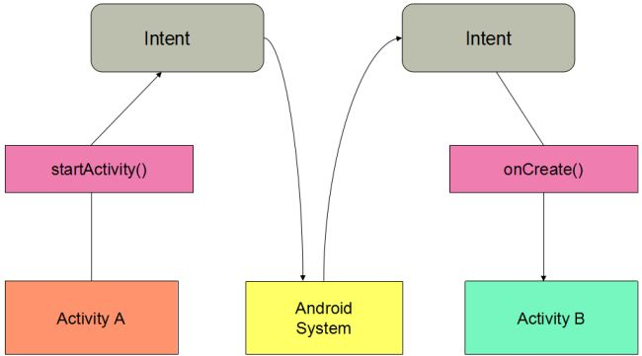
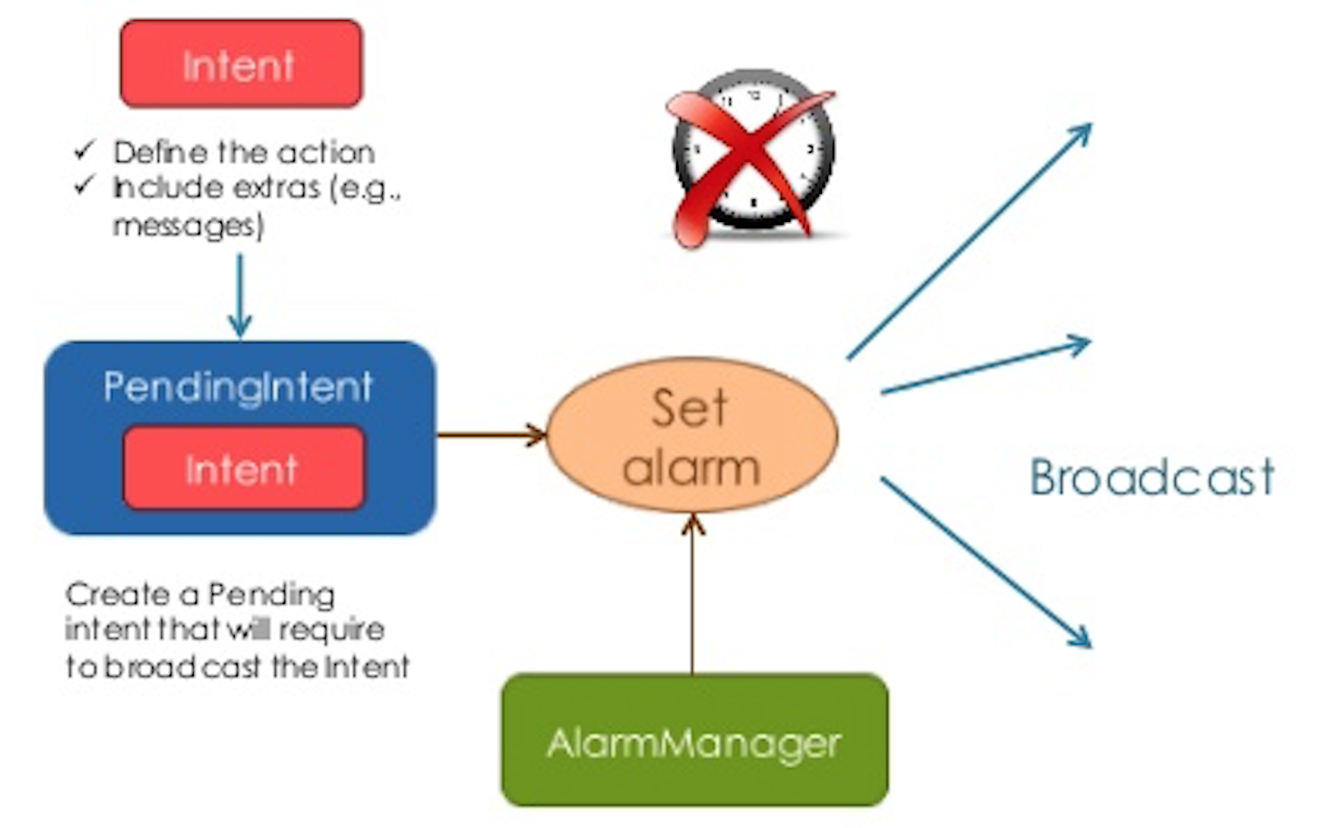
MOVING BETWEEN ACTIVITIES
INTENTS
Perform late runtime binding between the code in different applications
Used in the launching of activities
A passive data structure holding an abstract description of an action to be performed

Slide 20
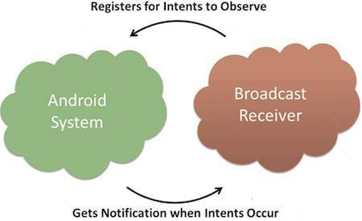
BROADCAST RECEIVERS
An Android component
Register for system events
Register for application events
Registered receivers for an event are notified by the Android runtime once this even happens

Slide 21
BROADCAST RECEIVERS

Slide 22
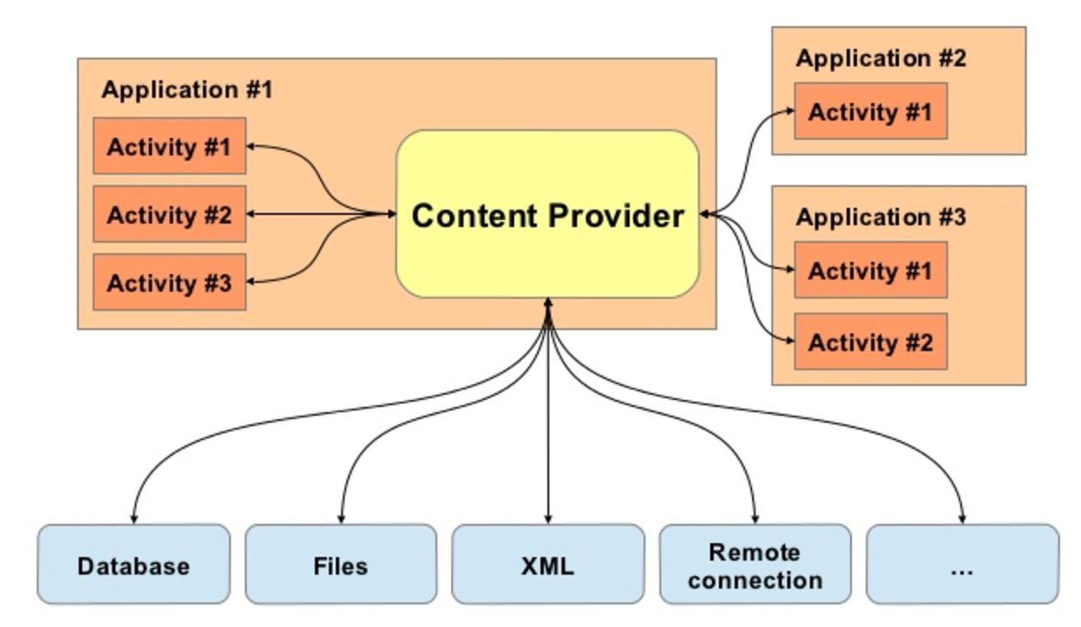
CONTENT PROVIDERS
Help an application manage access to data stored by itself
Provides a way to share data with other apps
Encapsulate the data, and provide mechanisms for defining data security.
EXAMPLE: Phone Contacts

Slide 23
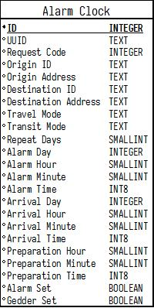
CONTENT PROVIDERS

Slide 24
SERVICES AND MANAGERS
Services:
Run in the background without a user interface
Ask the OS to do something on your behalf, like download a photo
Keeps the UI thread free to handle user interaction
Managers:
Provide access to various system services like Alarms

Slide 25
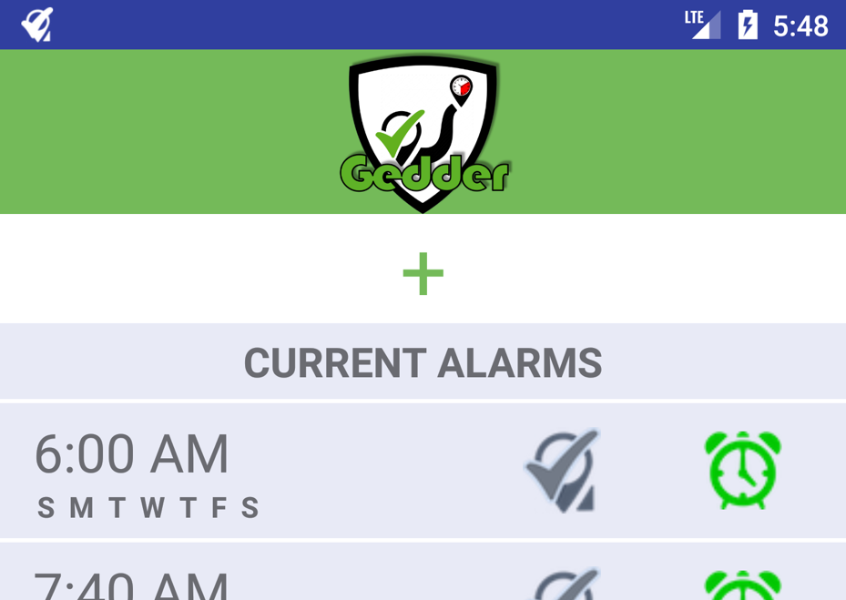
SERVICES AND MANAGERS
Alarm Manager:
Provides access to the system alarm services
How we use it:
Set Alarms for Gedder Engine to check travel-time
Set Alarm time for regular alarm clock
This is done through Pending Intents
Notification Manager:
Notifies the user of events that happen
How we use it:
A persistent icon that goes in the status bar if a Gedder Alarm is set

Slide 26

&

Slide 27

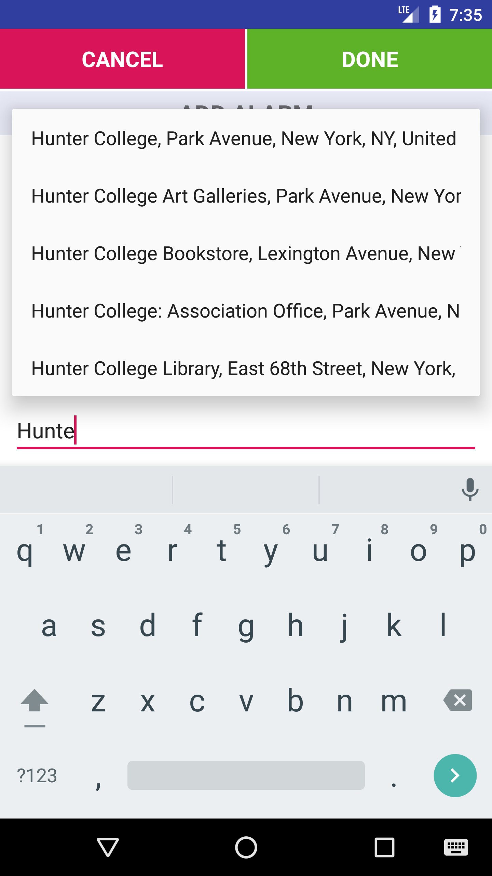
GOOGLE PLACES API
Autocomplete for Addresses
Search Businesses and nearby locations
Need Google API Key
How we used it:
Autocomplete origin and destination address

Slide 28
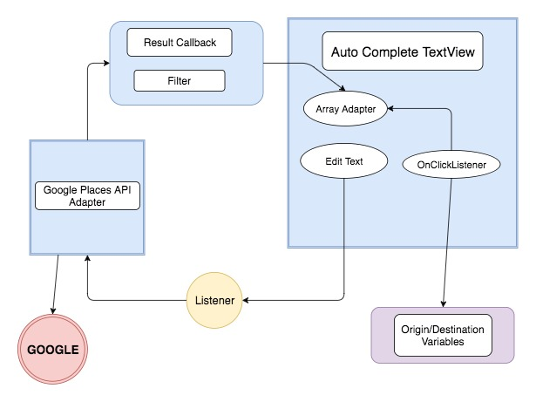
GOOGLE PLACES AND AUTO COMPLETE TEXT VIEW

Slide 29
GOOGLE MAPS (DIRECTIONS) API
Request format: JSON or XML
URL with:
Origin
Destination
API Key → https://console.developers.google.com/
Example:
https://maps.googleapis.com/maps/api/directions/
Json
?origin=695+Park+Ave,+New+York,+NY
&destination=New+York+University,+New+York,+NY+10003
&key=APIKEY

Slide 30
GOOGLE MAPS (DIRECTIONS) API
Origin/Destination:
Text String
“Hunter College”
Latitude/Longitude Coordinates
Place ID
Geocoded by Google
{
“geocoder_status” : "OK",
"place_id" : "ChIJwZVT9ZpZwokRBfO1cTF0MNo",
"types" : [ "establishment", "point_of_interest", "university" ]
}
"start_address" : "695 Park Ave, New York, NY 10065, USA",
"start_location" : {
"lat" : 40.7687399,
"lng" : -73.96542479999999
},
https://maps.googleapis.com/maps/api/directions/
Json
?origin=695+Park+Ave,+New+York,+NY
?origin=40.7687399,-73.96542479999999
?origin=place_id:ChIJwZVT9ZpZwokRBfO1cTF0MNo
&destination=New+York+University,+New+York,+NY+10003
&key=APIKEY
Choose
Between:

Slide 31
GOOGLE MAPS (DIRECTIONS) API
RECOMMENDED ADDITIONAL PARAMETERS:
Travel Modes
Driving
Walking
Bicycling
Transit
Mode: Subway, Bus, Train, Tram, Rail
Routing Preference: Less walking or Fewer Transfers
Avoid
Tolls
Highways
Ferries
Alternative routes
Same example from before:
https://maps.googleapis.com/maps/api/directions/json?origin=695+Park+Ave,+New+York,+NY&destination=New+York+University,+New+York,+NY+10003&key=APIKEY&...
+
…&mode=driving&avoid=tolls|highways&departure_time=1541202457&alternatives=true
OR
…&mode=transit&transit_mode=train&transit_routing_preference=less_walking&arrival_time=1541202457
Note: Arrival/Departure Time is in Unix Time == Seconds since Jan 1st 1970

Slide 32
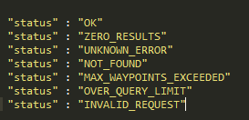
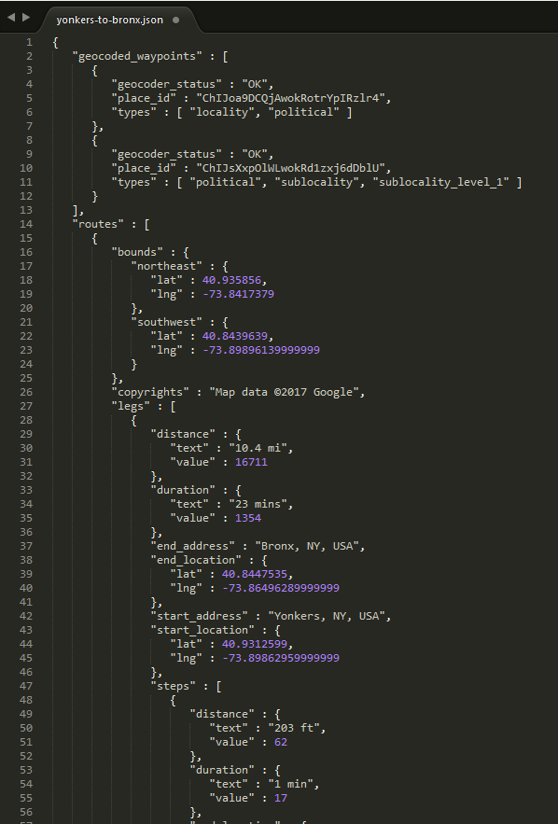
GOOGLE MAPS (DIRECTIONS) API
UNDERSTANDING RESPONSE (JSON)
Important Information
Status
Location information
Place ID, Text String or Lat/Long Coordinates

Slide 33
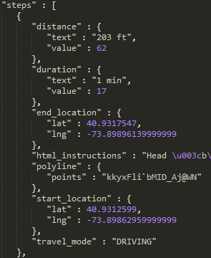
GOOGLE MAPS (DIRECTIONS) API
UNDERSTANDING RESPONSE (JSON)
Important Information
Route information
Legs
Steps
Coordinates of each step
Instructions
Travel Mode
Note: Values are returned in meters and seconds

Slide 34

Download
Gedder
You can get our app (APK) from GitHub:
https://github.com/GedderAlarm/GedderAlarm/tree/csci499/app/build/outputs/apk/app-debug.apk
Or download it directly to your phone:
Here
https://github.com/GedderAlarm/GedderAlarm/raw/csci499/app/build/outputs/apk/app-debug.apk
Or through our website:
https://gedderalarm.github.io/
Please help us discover bugs

Slide 35
QUESTIONS

Slide 36
THANK YOU

